Slide 1
Shortest Path Algorithms and Steiner Tree Optimization for Emergency Response
A Comparative Analysis of Dijkstra's and Steiner Tree Algorithms
Presented By: [ABDUL WASEY (22K-4172)
SAAD ARSHAD (22K-4141)
MUHAMMAD HAMZA (22K-4523)]
Date: [02/12/2024]

Slide 2
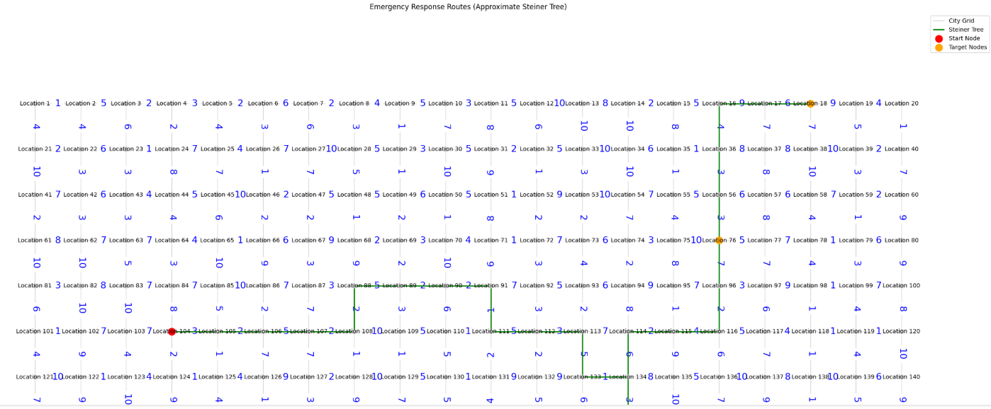
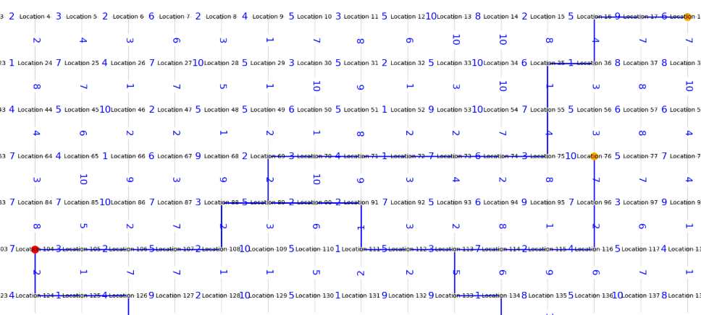
Introduction
Steiner Tree:
Objective:
To implement Dijkstra’s algorithm for shortest paths to multiple emergency sites.
To implement a Steiner Tree algorithm for connecting multiple target nodes efficiently.
To compare their performance based on execution time, and memory usage.
Importance:
Emergency responses depend on fast, efficient route planning.
Reducing response time saves lives and resources.
Shortest Path

Slide 3
Introduction
Introduction
Steiner Tree:

Slide 4
Introduction
Introduction
Steiner Tree:
Objective:
To implement Dijkstra’s algorithm for shortest paths to multiple emergency sites.
To implement a Steiner Tree algorithm for connecting multiple target nodes efficiently.
To compare their performance based on execution time, and memory usage.
Importance:
Emergency responses depend on fast, efficient route planning.
Reducing response time saves lives and resources.
Shortest Path

Slide 5
Introduction
Introduction
Introduction
Shortest Path

Slide 6
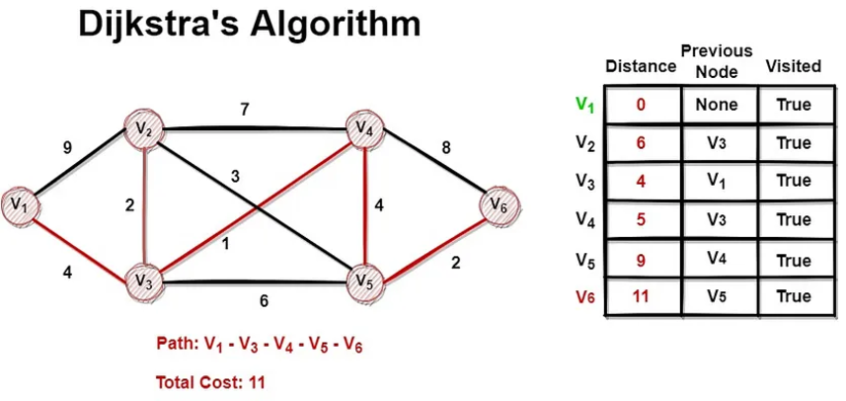
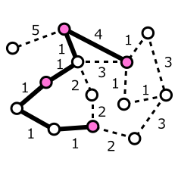
Algorithms Overview
Dijkstra’s Algorithm:
Finds the shortest path from a source to all nodes in a weighted graph.
Efficient for graphs with non-negative weights.
Steiner Tree Algorithm:-
Connects multiple points (terminals) using the minimum combined edge weight.
Used in network design and logistics.
STEINER TREE

Slide 7
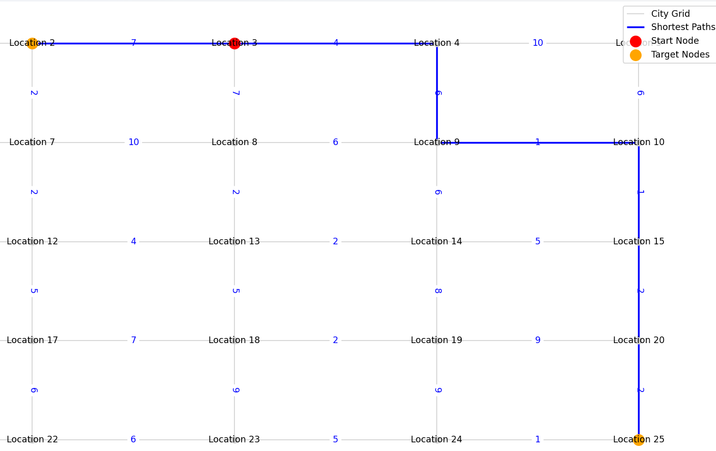
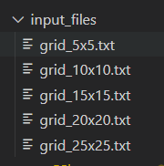
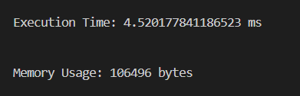
System Design
Input Structure:
Graph represented as nodes (locations) and edges (routes with weights).
START node, TARGETS, and edges in text file format.
Output Structure:
Shortest paths between the START node and TARGET nodes.
Steiner Tree connecting all required nodes.
Modular Design:
Components: Graph, Point, Edge, Algorithms, and Efficiency Analysis.

Slide 8
System Design

Slide 9
Code Implementation C#

Slide 10
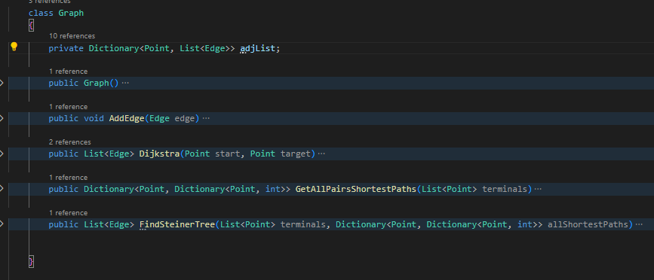
Code Implementation C#
Graph class: Manages nodes, edges, and algorithms.

Slide 11
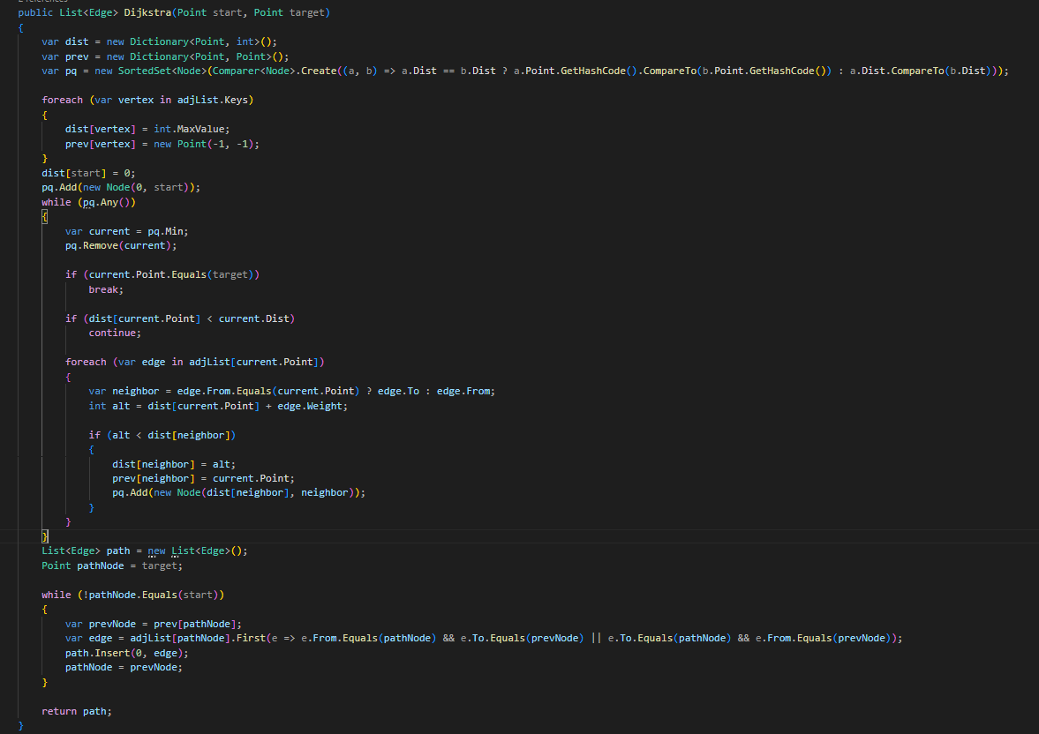
Code Implementation C#
Code Implementation C#
Dijkstra’s algorithm implementation: Calculates shortest paths.

Slide 12
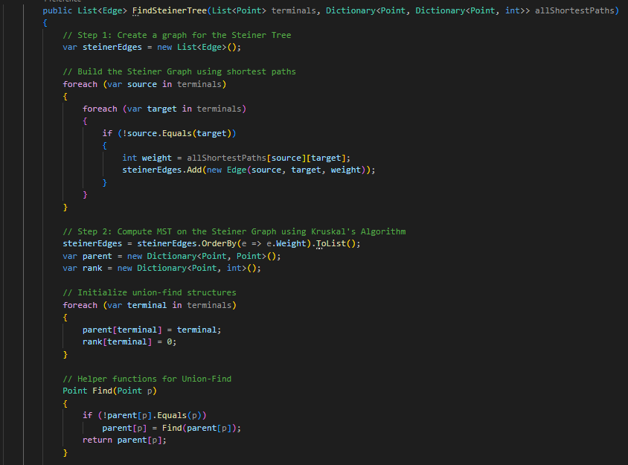
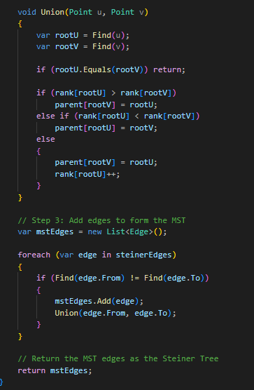
Code Implementation C#
Steiner Tree construction: Combines shortest paths into an optimized tree.

Slide 13
Code Implementation PYTHON
Code Implementation Python

Slide 14
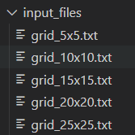
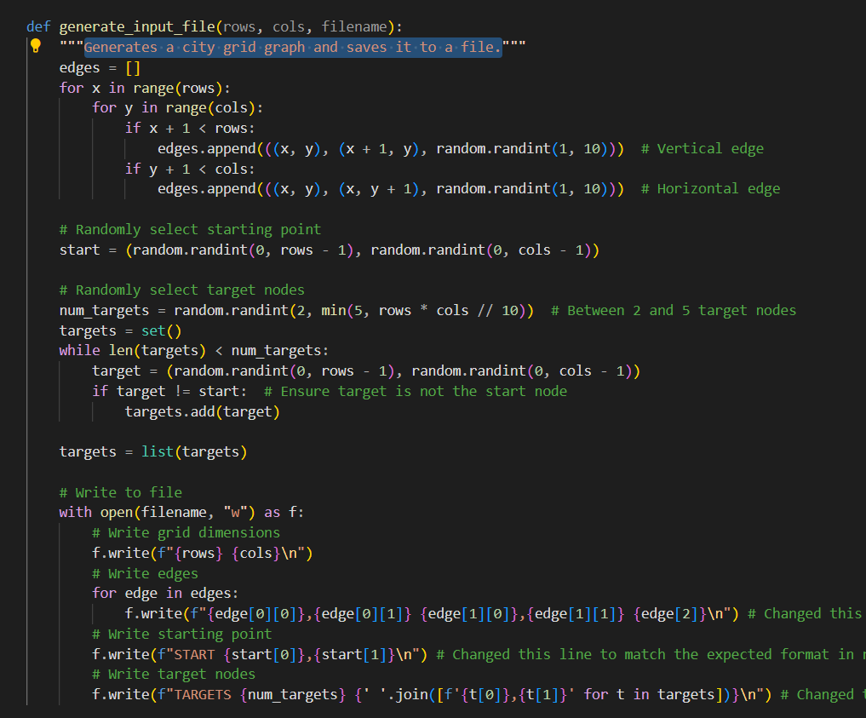
Code Implementation PYTHON
Generate_input_file(): Generates a city grid graph and saves it to a file. The files generated are of varying data sizes, and saved into the input_files directory.

Slide 15
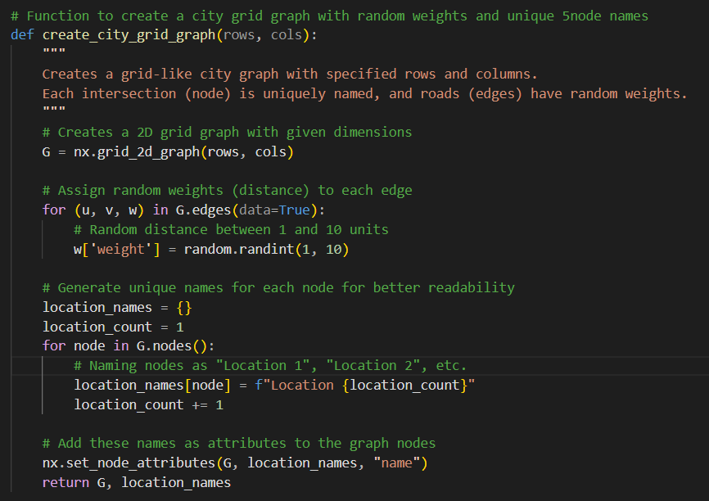
Code Implementation PYTHON
create_city_grid_graph(): Creates a grid-like city graph with specified rows and columns. Each intersection (node) is uniquely named, and roads (edges) have random weights.

Slide 16
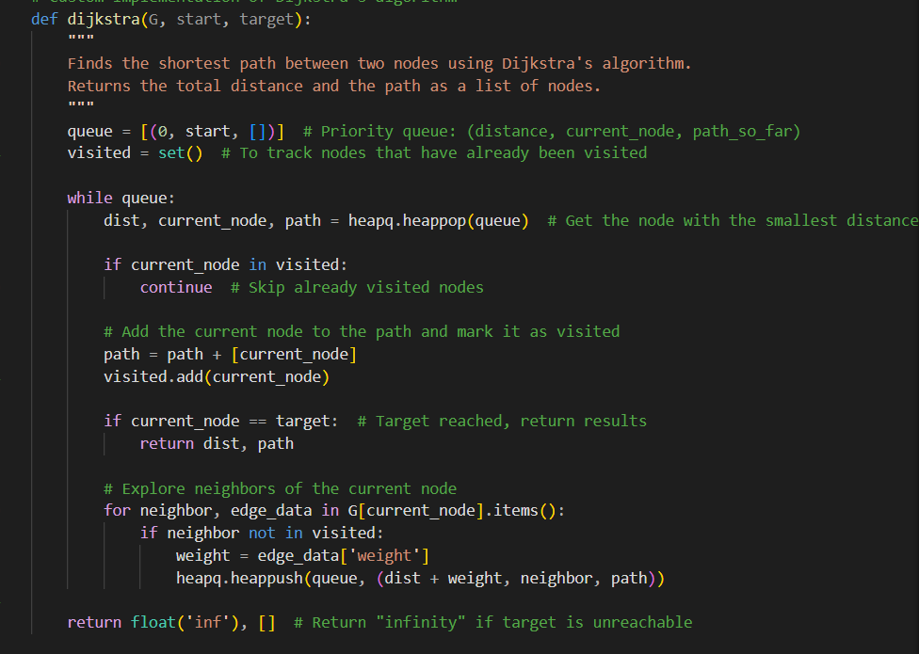
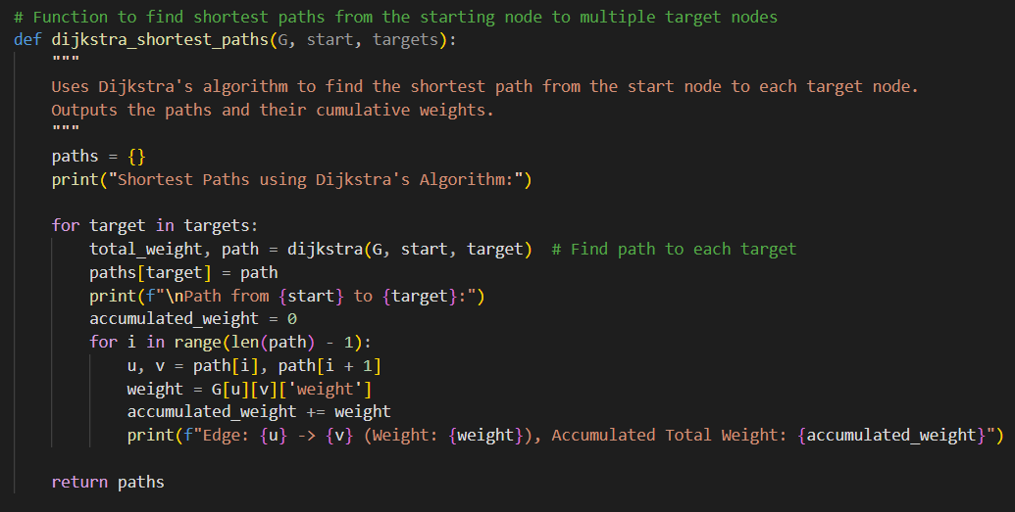
Code Implementation PYTHON
Dijkstra’s algorithm implementation: Uses Dijkstra's algorithm to find the shortest path from the start node to each target node. Outputs the paths and their cumulative weights.

Slide 17

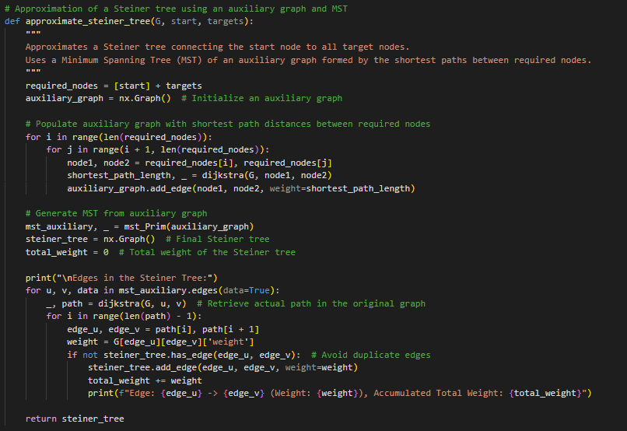
Code Implementation PYTHON
Steiner Tree construction: Approximates a Steiner tree connecting the start node to all target nodes. Uses a Minimum Spanning Tree (MST) of an auxiliary graph formed by the shortest paths between required nodes.

Slide 18
Code Implementation PYTHON
VISUALIZE SHORTEST PATHS & STEINER TREE: Visualizes the city graph, shortest paths (in blue color) and Steiner tree (in green color) on a plot with location names.
Steiner Tree:
Shortest Path

Slide 19
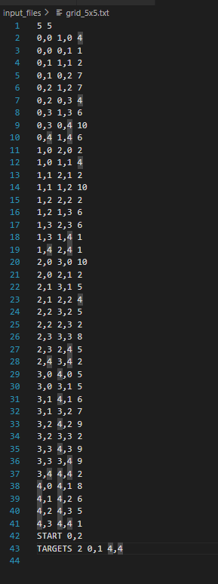
Input Files
Format:
Grid Dimension: Specifies the grid dimension (e.g., 5 5 indicates 5x5 grid).
Graph edges with weights: X1,Y1 X2,Y2 Weight (e.g., 0,0 1,1 2 indicates the edge between coordinates 0,0 and 1,1 is weighted 2).
START: Identifies the starting point (e.g., START 2,4 indicates that 2,4 is the starting point).
TARGETS: Identifies the number of target locations and their coordinates (e.g., TARGETS 2 0,1 4,4 indicates that there are 2 targets, and their coordinates are 0,1 and 4,4)

Slide 20
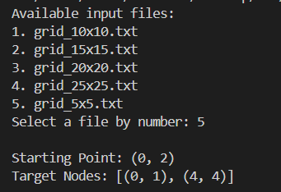
Output Explanation
The user is asked to select one of the five files generated before.
After reading the selected file, the starting point and all the target nodes are printed

Slide 21
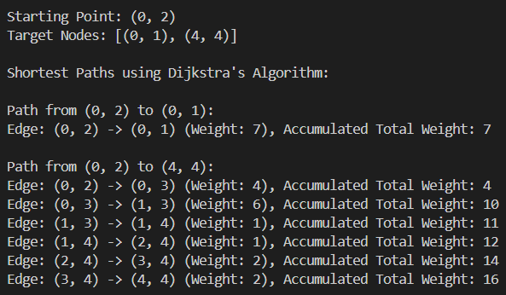
Output Explanation
After reading the grid from the selected file, two outputs are generated:
Dijkstra’s Output:
Lists the shortest path from START to each TARGET.

Slide 22
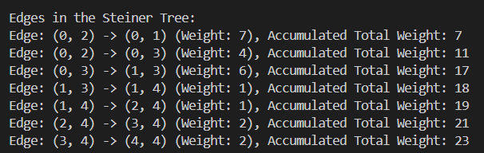
Output Explanation
After reading the grid from the selected file, two outputs are generated:
2. Steiner Tree Output:
Lists the edges in the Steiner tree with their respective weights and the accumulated total weight in each step.

Slide 23
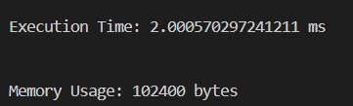
Output Explanation
After reading the grid from the selected file, two outputs are generated:
Memory and Execution Time metrics

Slide 24
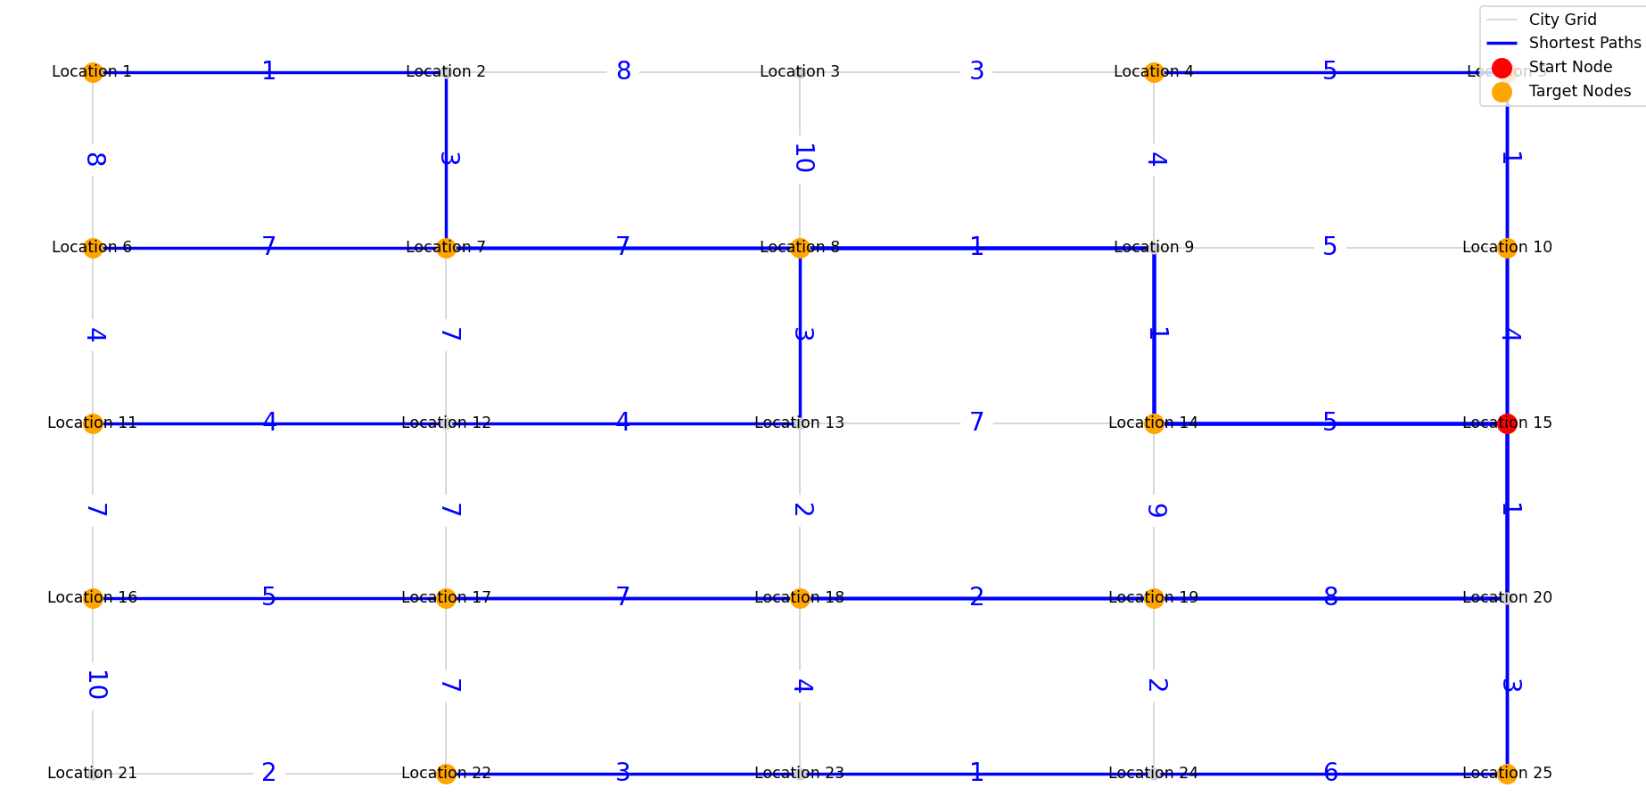
Output Explanation
After reading the grid from the selected file, two outputs are generated:
Visualization Dijkstra’s Output:

Slide 25
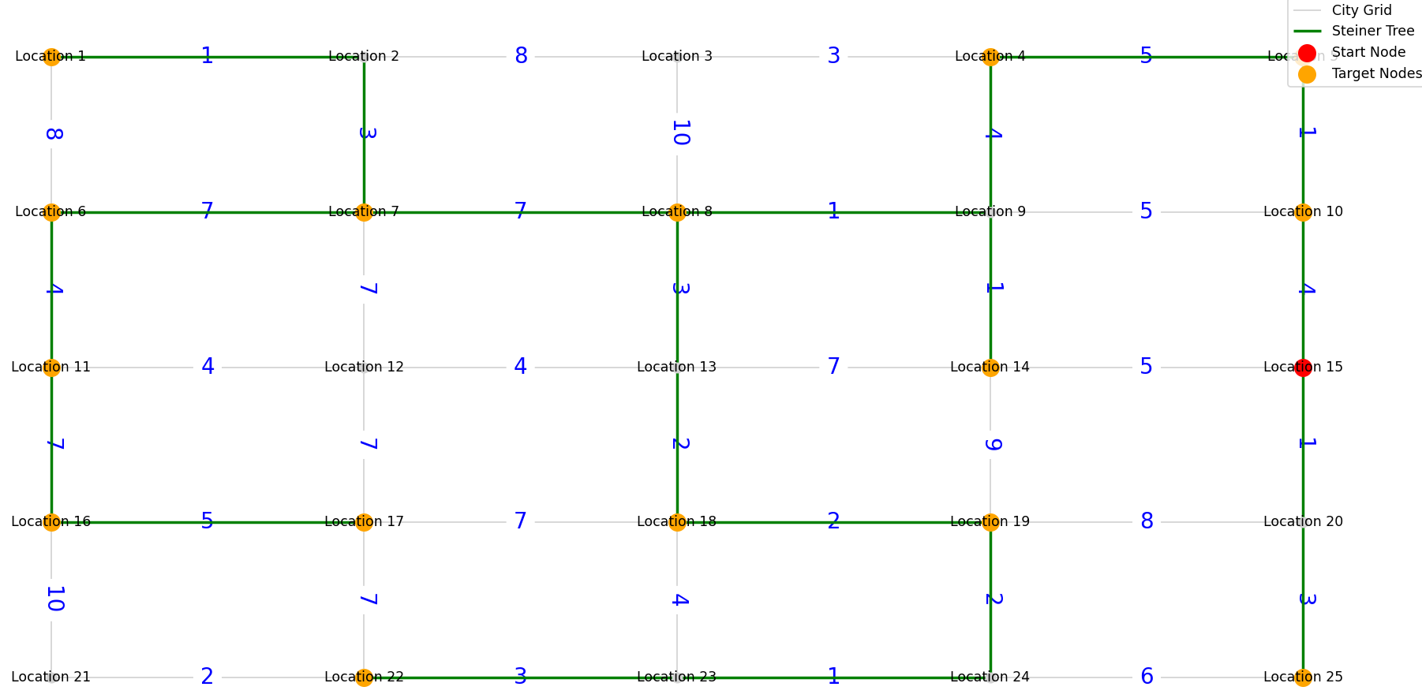
Output Explanation
After reading the grid from the selected file, two outputs are generated:
Visualization Steiner Tree Output:

Slide 26
Efficiency Analysis
Execution Time Comparison
Grid Size (Targets) | C# Execution Time (ms) | Python Execution Time (ms) | Winner
5x5 (15 targets) | 129 | 282.25 | C# (faster)
10x10 (9 targets) | 159 | 74.82 | Python (faster)
15x15 (14 targets) | 472 | 292.22 | Python (faster)
20x20 (6 targets) | 264 | 192.48 | Python (faster)
25x25 (7 targets) | 324 | 228.86 | Python (faster)
Observations on Execution Time:
C# performs better on small grid sizes with many targets (e.g., the 5x5 grid).
Python outperforms C# for larger grid sizes with fewer targets, suggesting better handling of certain data manipulations and optimizations.
Python's overhead in smaller grids might be due to its interpreted nature, while its libraries (e.g., NumPy) excel in optimized operations for larger, complex data structures.

Slide 27
Efficiency Analysis
Memory Usage Comparison
Grid Size (Targets) | C# Memory Usage (bytes) | Python Memory Usage (bytes) | Winner
5x5 (15 targets) | 1,367,984 | 155,648 | Python(efficient)
10x10 (9 targets) | 769,608 | 270,336 | Python(efficient)
15x15 (14 targets) | 1,011,000 | 581,632 | Python(efficient)
20x20 (6 targets) | 1,003,096 | 831,488 | Python(efficient)
25x25 (7 targets) | 1,203,592 | 1,404,928 | C# (efficient)
Observations on Memory Usage:
Python consistently uses less memory for smaller grid sizes with fewer targets.
C# overtakes Python in efficiency for larger grids with increased complexity, likely due to its static typing and memory management mechanisms.
Python’s increased memory usage on larger grids may result from dynamic typing and object-oriented overhead.

Slide 28
Results and Insights
Strengths of C#:
Performance: Its compiled nature and efficient memory handling result in better performance in smaller grids and high-target scenarios.
Scalability: C# handles large, complex structures with relatively consistent memory usage, making it better suited for production environments with large data loads.
Libraries and Features: Robust support for .NET libraries, threading, and parallel processing can further optimize performance.
Weaknesses of C#:
Development Speed: More verbose syntax and a need for explicit data structure definitions can slow down prototyping
Platform Dependency: Requires the .NET runtime, which may not be as portable as Python.

Slide 29
Results and Insights
Strengths of Python
Ease of Use: Simpler syntax and dynamic typing make it excellent for quick prototyping and debugging.
Optimized Libraries: Libraries like NumPy and networkx provide high-level abstractions and efficient implementations for graph algorithms.
Portability: Python's cross-platform nature ensures broad usability.
Weaknesses of Python
Performance: Python is slower in execution time due to its interpreted nature, especially in computationally intensive scenarios.
Memory Overhead: Dynamic typing and object-oriented structures can lead to higher memory usage in certain cases.

Slide 30
Conclusion
Successfully implemented and compared algorithms.
Valuable insights into algorithm efficiency and application.

Slide 31
THANK YOU!!

